Slide 1


Face Recognition System
Presented By : Mungarlla Sai Charitha Yadav
Intern ID : MST03-0066
Guided By : Urooj Khan

Slide 2

Project Objectives
Build a face recognition system using STREAMLIT
Creating an interface that supports the addition of new faces into the database.
Clearly distinguishes between all the faces that are present in the database

Slide 3
Introduction to Face Recognition
1 | Face recognition is a biometric technology used to identify or verify individuals based on their facial features.
2 | It involves capturing, analyzing, and comparing patterns from a person's face, often through images or video.
3 | This technology is widely used in security systems, access control, and personal identification.
4 | Face recognition systems typically rely on deep learning algorithms and neural networks for accurate detection and recognition.
5 | The process involves key steps like face detection, feature extraction, and matching against a database of known faces.
6 | Face recognition offers a contactless and convenient method of authentication compared to other biometric systems like fingerprint scanning.

Slide 4





Python
Open CV
Technologies Used
Streamlit
Numpy
Pillow

Slide 5

Streamlit
Streamlit is an open-source library used for building interactive web applications with Python.
Streamlit
Simplicity: Write Python scripts to create interactive applications without needing to learn JavaScript, HTML, or CSS.
Real-Time Updates: Automatically updates the app as users interact with widgets and input elements.
Widgets: Includes a variety of widgets like sliders, buttons, and text inputs to capture user inputs and interact with data.
Integration: Works seamlessly with popular data science libraries and frameworks, making it easy to visualize data and models.
Components
Cloud
Sub-libraries or components of Streamlit

Slide 6

Workings
Import Libraries: Imports necessary libraries like Streamlit, OpenCV, and PIL for building the app and handling image processing.
Train Recognizer: Defines train_recognizer to train an LBPH face recognizer with images of known faces stored in the data_path directory.
Save Face: Defines save_face to save a newly uploaded face image into a unique directory based on the person's name.
Initialize Recognizer: Loads and trains the face recognizer with existing known faces if available, otherwise sets it to None.
Streamlit UI: Sets up the Streamlit app with options to either add a new face or identify faces from a webcam feed.
Add Face Mode: In "Add Face" mode, the app allows users to upload an image and enter a name, saves the image, and retrains the recognizer with the new data.
Identify Face Mode: In "Identify Face" mode, captures video from the webcam, detects faces, and predicts the identity using the trained recognizer.
Display Results: Draws rectangles around detected faces, labels them with predicted names, and shows the video feed in the Streamlit app.

Slide 7
Project path
1
2
3
Initialization
The app initializes by loading or training a face recognizer with existing known faces from the known_faces directory.
Add Face Mode
In "Add Face" mode, user uploads an image, which is saved and used to retrain the face recognizer with new face data.
Identify Face Mode
In "Identify Face" mode, the app captures video from the webcam, detects faces, and predicts identities using the trained recognizer.

Slide 8

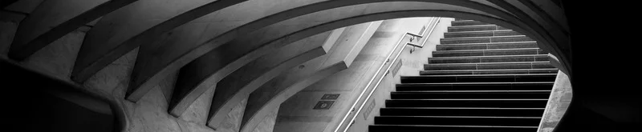
Applications
Attendance Management: Automatically track attendance in classrooms, offices, and events by recognizing faces.
Criminal Record Check: Identify known criminals during investigations by comparing faces with a database of criminal records.
Security Systems: Enhance security in restricted areas by allowing access only to authorized personnel.
Customer Recognition: Improve customer service in retail by recognizing regular customers and offering personalized services.
Event Management: Streamline check-ins at events and conferences by recognizing attendees as they arrive.

Slide 9
This project successfully demonstrates the implementation of The Face Recognition App is built using Streamlit and OpenCV, designed to be both powerful and user-friendly. .
Conclusion
It enables users to add and identify faces easily, making it valuable for various real-world applications
It supports real-time face recognition with seamless webcam integration.
The app is open-source and customizable, offering the flexibility to extend it with additional features as needed.

Slide 10
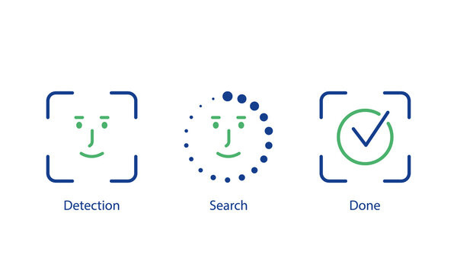

THANK YOU!

